Slide 1
HOUSING PRICES PREDICTION
Data analysis (Video link: https://youtu.be/mnID8VA6gxE)
By
Naveen.S.S
200447929 (Student Id)

Slide 2
Dataset
The dataset used in this presentation is Ames Housing Dataset for predicting housing prices in the city of Ames, Iowa.
This dataset is compiled by Dean de Cook from Truman State University.
It has 79 explanatory variables describing every aspect of residential homes in Ames, Iowa.

Slide 3
Customer request
Our customer who recently moved to Ames, Iowa has asked us to build a model to find his dream house in the city and he has stated the following requirements
He wants us to find us a house in a neighborhood with good commute.
He wants a house with at least 3 bedrooms.
He wants a house with all basic utilities like water, electricity, gas etc.
He also wants a house with a garage.
Finally, his price range is between $100,000 and $250,000.

Slide 4
Addition request
On top of that, he wants us to draw a graph showing the projection of house prices among neighborhoods in the city to help him an informed decision.

Slide 5
Pivot table
To build our model, we will be using an excel pivot table using which we will perform data analysis on our dataset to find the ideal house for our customer.
We will be using the average of Sale Price in the Values field.
The columns Neighborhood and BedroomAbvGr in the Rows field.
The column Bldgtype i.e., the building type in the column field.
The columns Utilities, Garage Type, Condition1 in the filter field.

Slide 6
Filter the data
Now we filter our dataset with our client specifications to find our clients dream house,
In the row field, we set value of BedroomAbvGr as 3 or above to filter our houses with more than three bedrooms.
In the Neighborhood field, we set the average sale price between $100,000 and $250,000.
In the filters field, we set the value of Utilities as AllPub since our customer needs all basic utilities in his house.
In the Garage Type field, we deselect the NA value in the filter to remove the houses without a garage in our model.

Slide 7
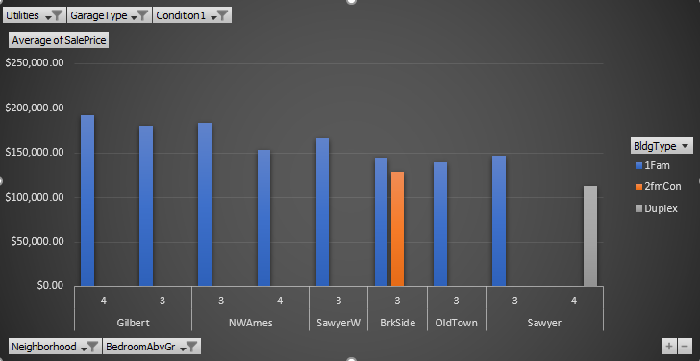
Pivot chart
In order to make our model more appealing to the client we create a pivot chart,

Slide 8
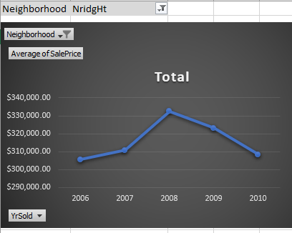
Price projections
As per our client’s request, we can create a price projection model by projecting the sale price against the year of purchase.

Slide 9
Observations
As per our client specifications, our model predicts the neighborhoods that are ideal for our customer.
We have successfully a model that predicts the ideal house that has,
At least 3 bedrooms
Price between $150,000 and $200,000
All basic utilities.
Including a garage.
With Excellent commute.

Slide 10
References
https://www.kaggle.com/c/home-data-for-ml-course/overview/evaluation
http://jse.amstat.org/v19n3/decock.pdf
https://www.linkedin.com/learning/excel-pivottables-in-depth/work-in-depth-with-pivottables?u=2175986
https://www.youtube.com/watch?v=ioN1jcWxbv8&t=39s

